Slide 1

Penang
Balik Pulau

Slide 2
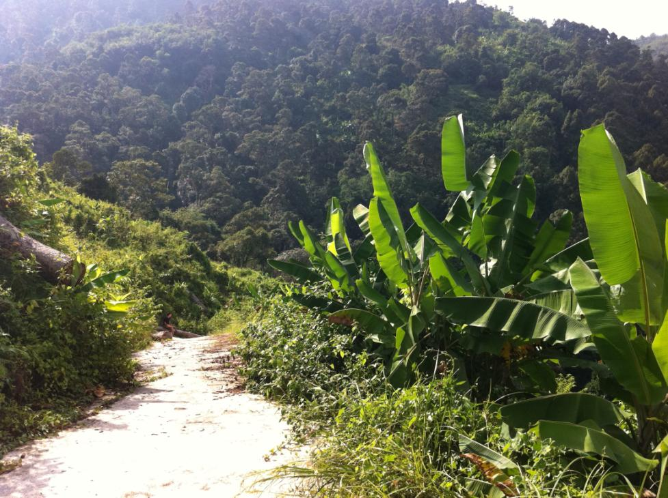
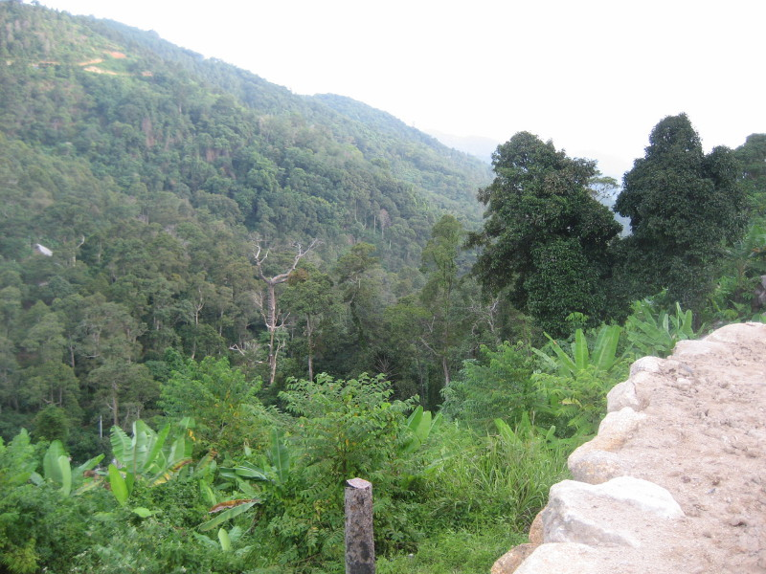
The humble beginning …
Ven Sayalay Susila expresses gratitude to all donors; one acre of land has been successfully procured in year 2012
Sadhu, Sadhu, Sadhu!

Slide 3
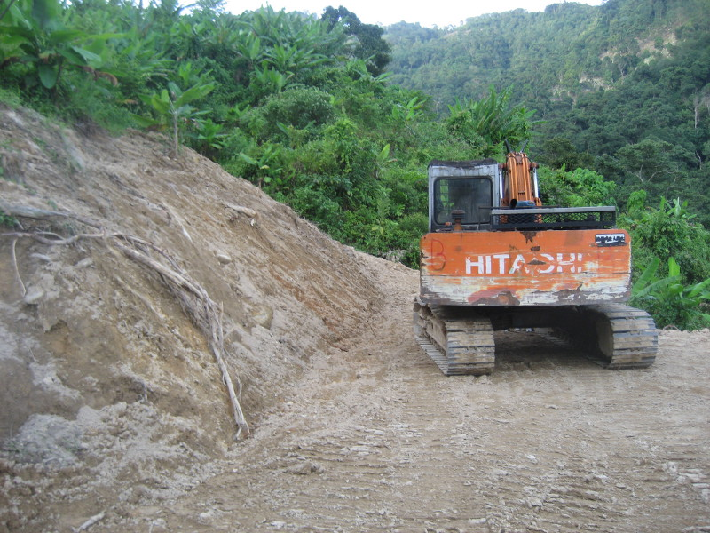
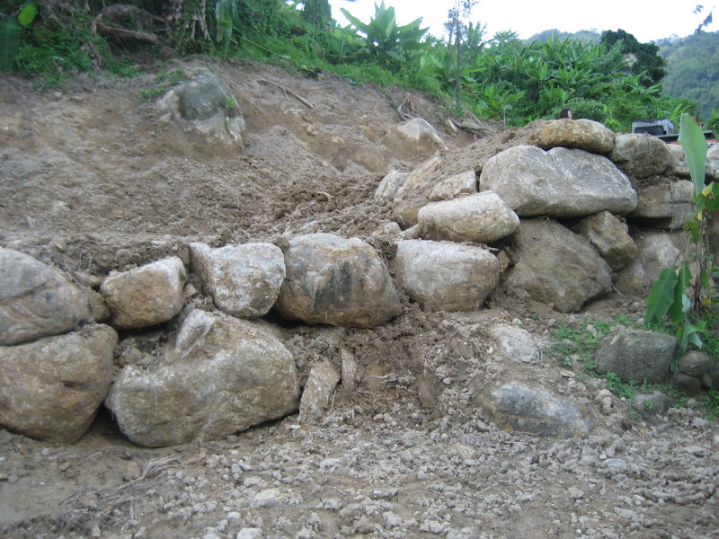
The present …
Land has been cleared
Initial construction works
like fencing & groundwork have begun

Slide 4
The vision for the future
… construction work starts this October 2013
Building 1:
  2-storey dormitory & dining
Building 2:
  2-storey meditation hall & dormitory
Building 3:
  2 kutis

Slide 5
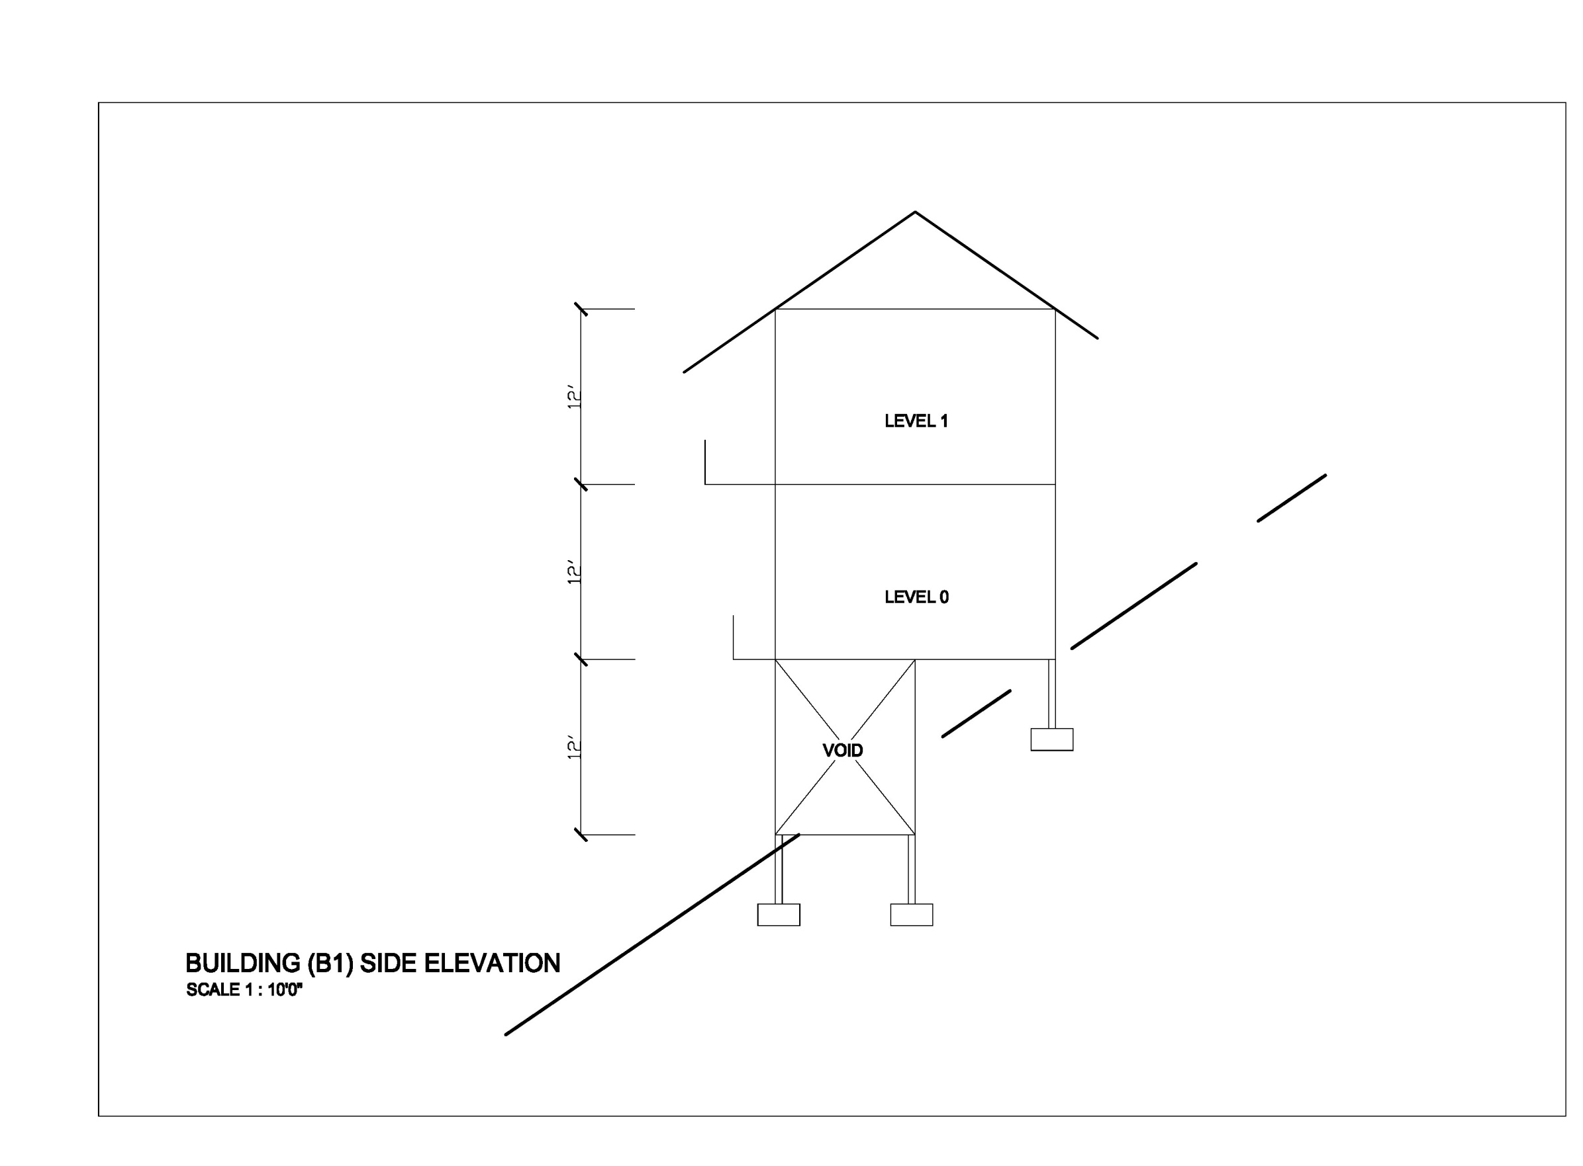

Slide 6
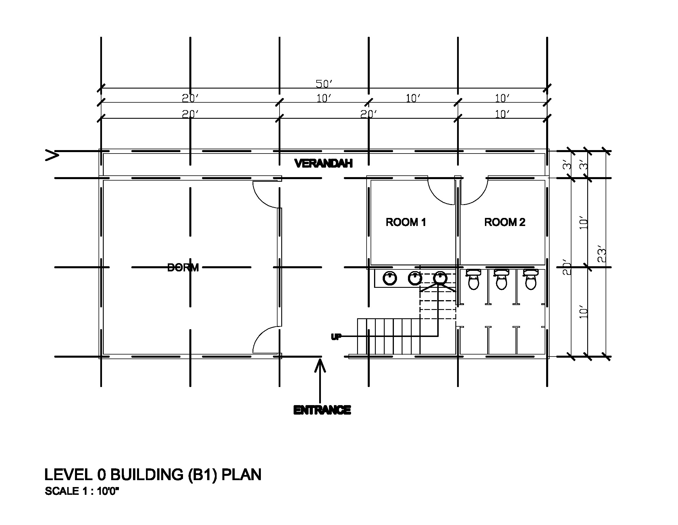

Slide 7
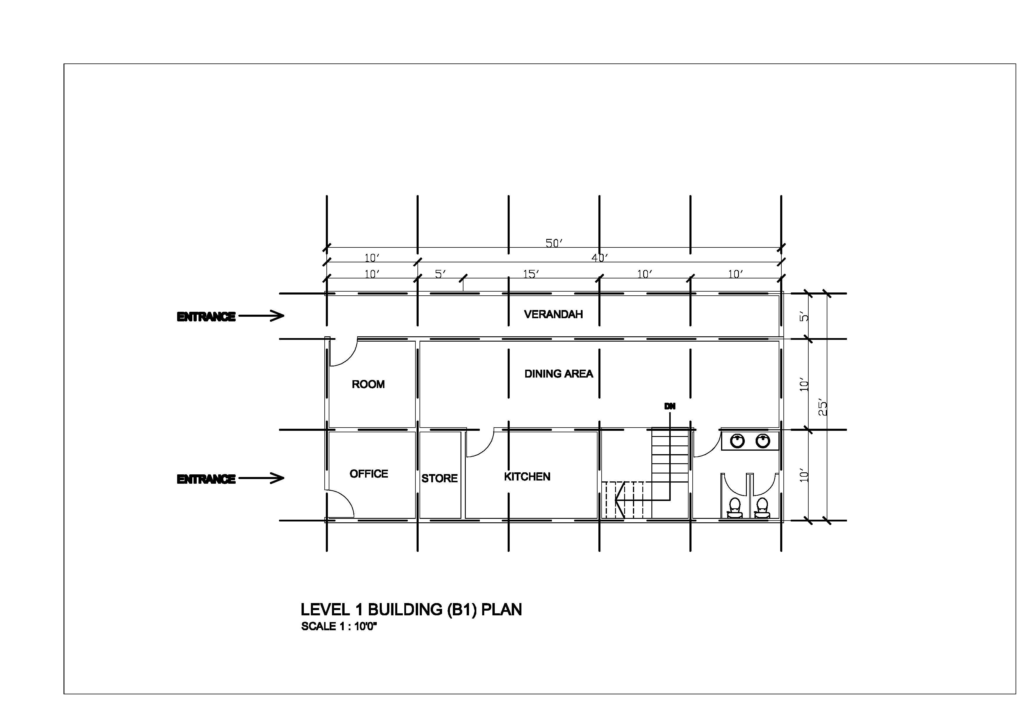

Slide 8
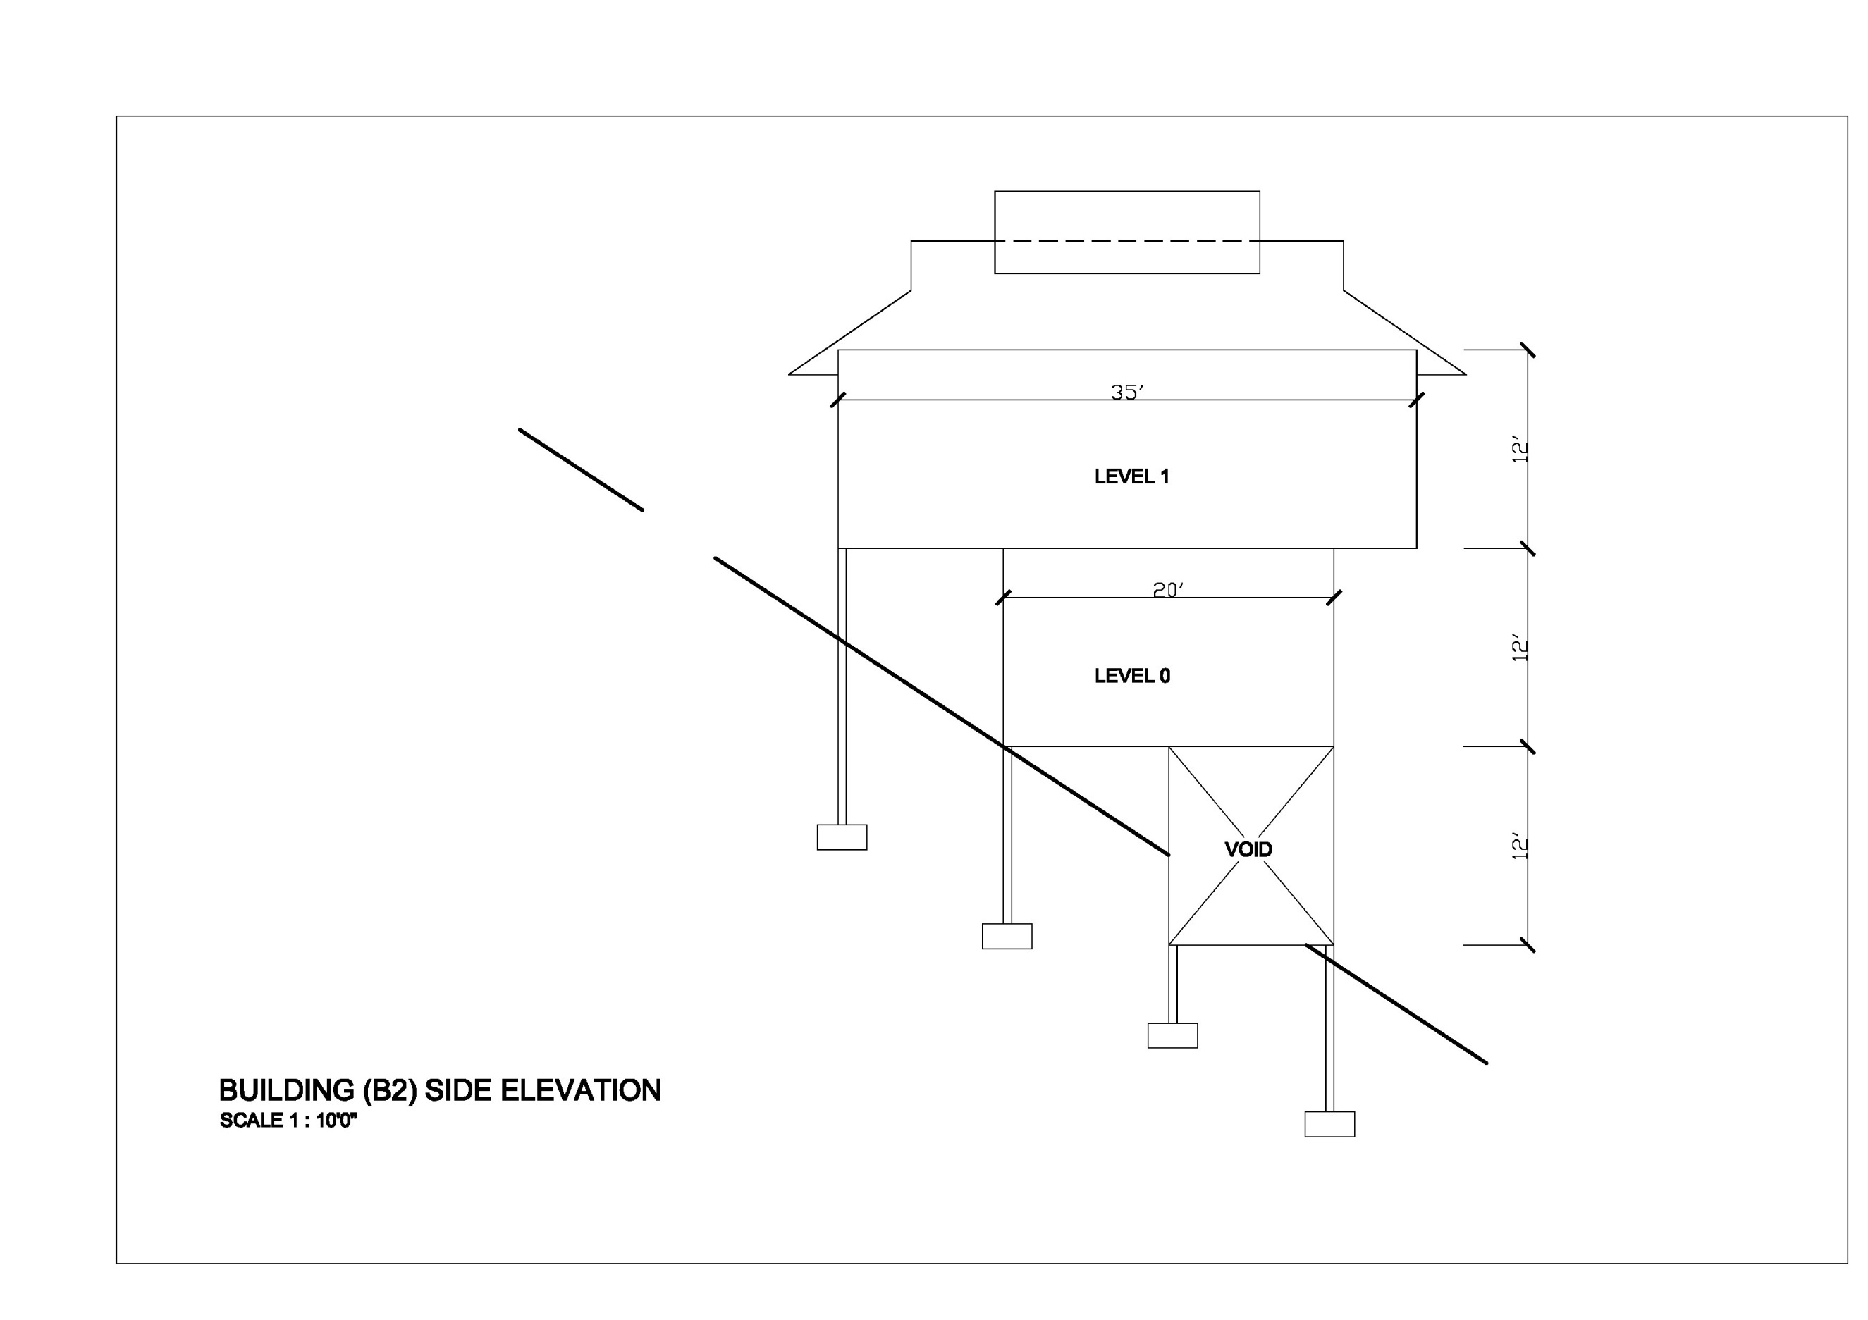

Slide 9
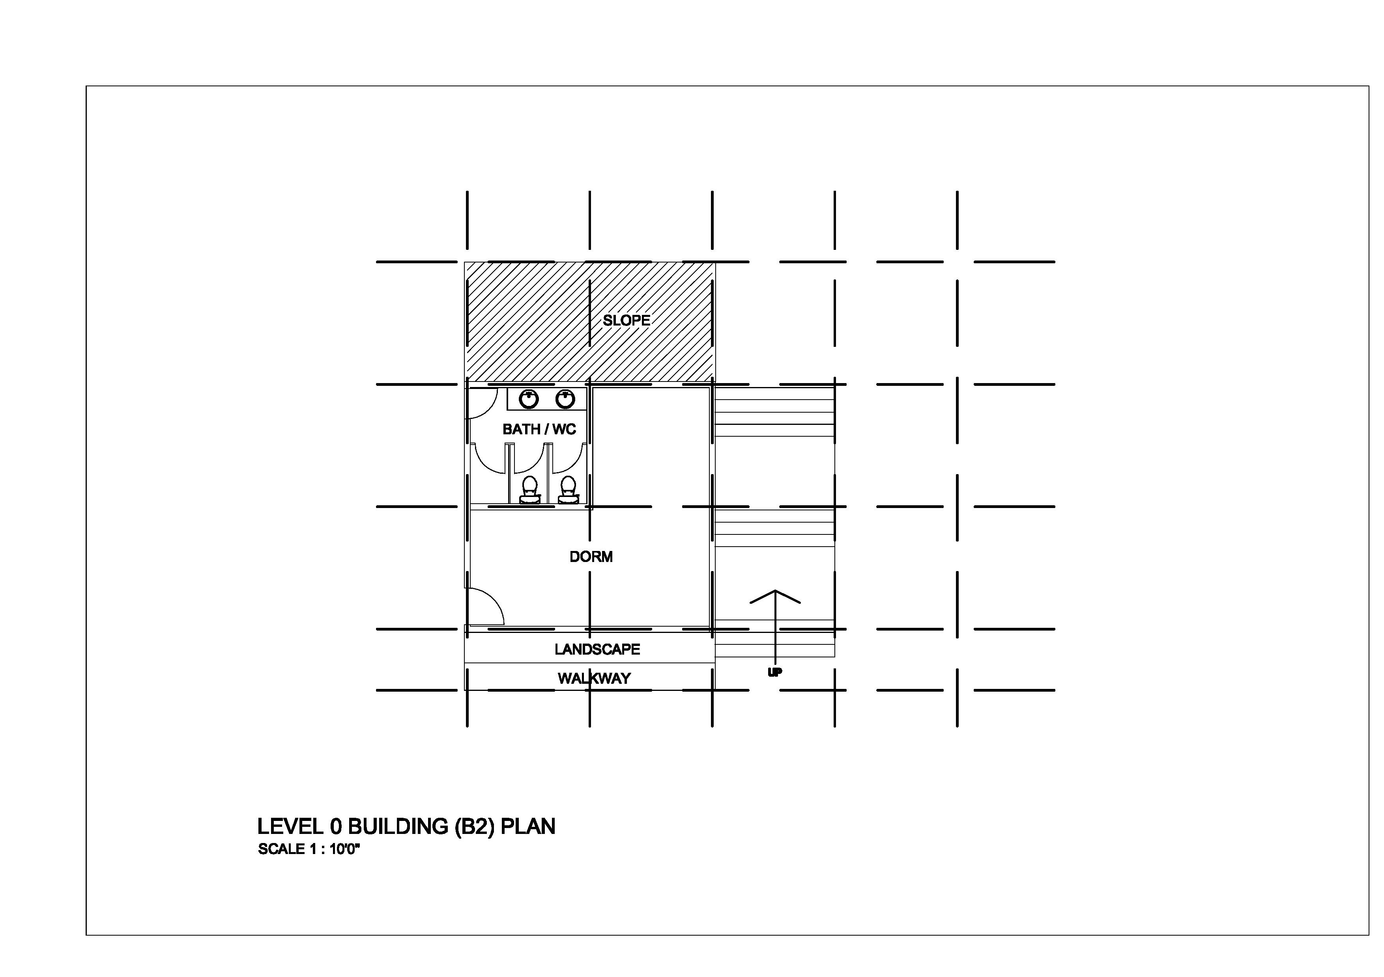

Slide 10
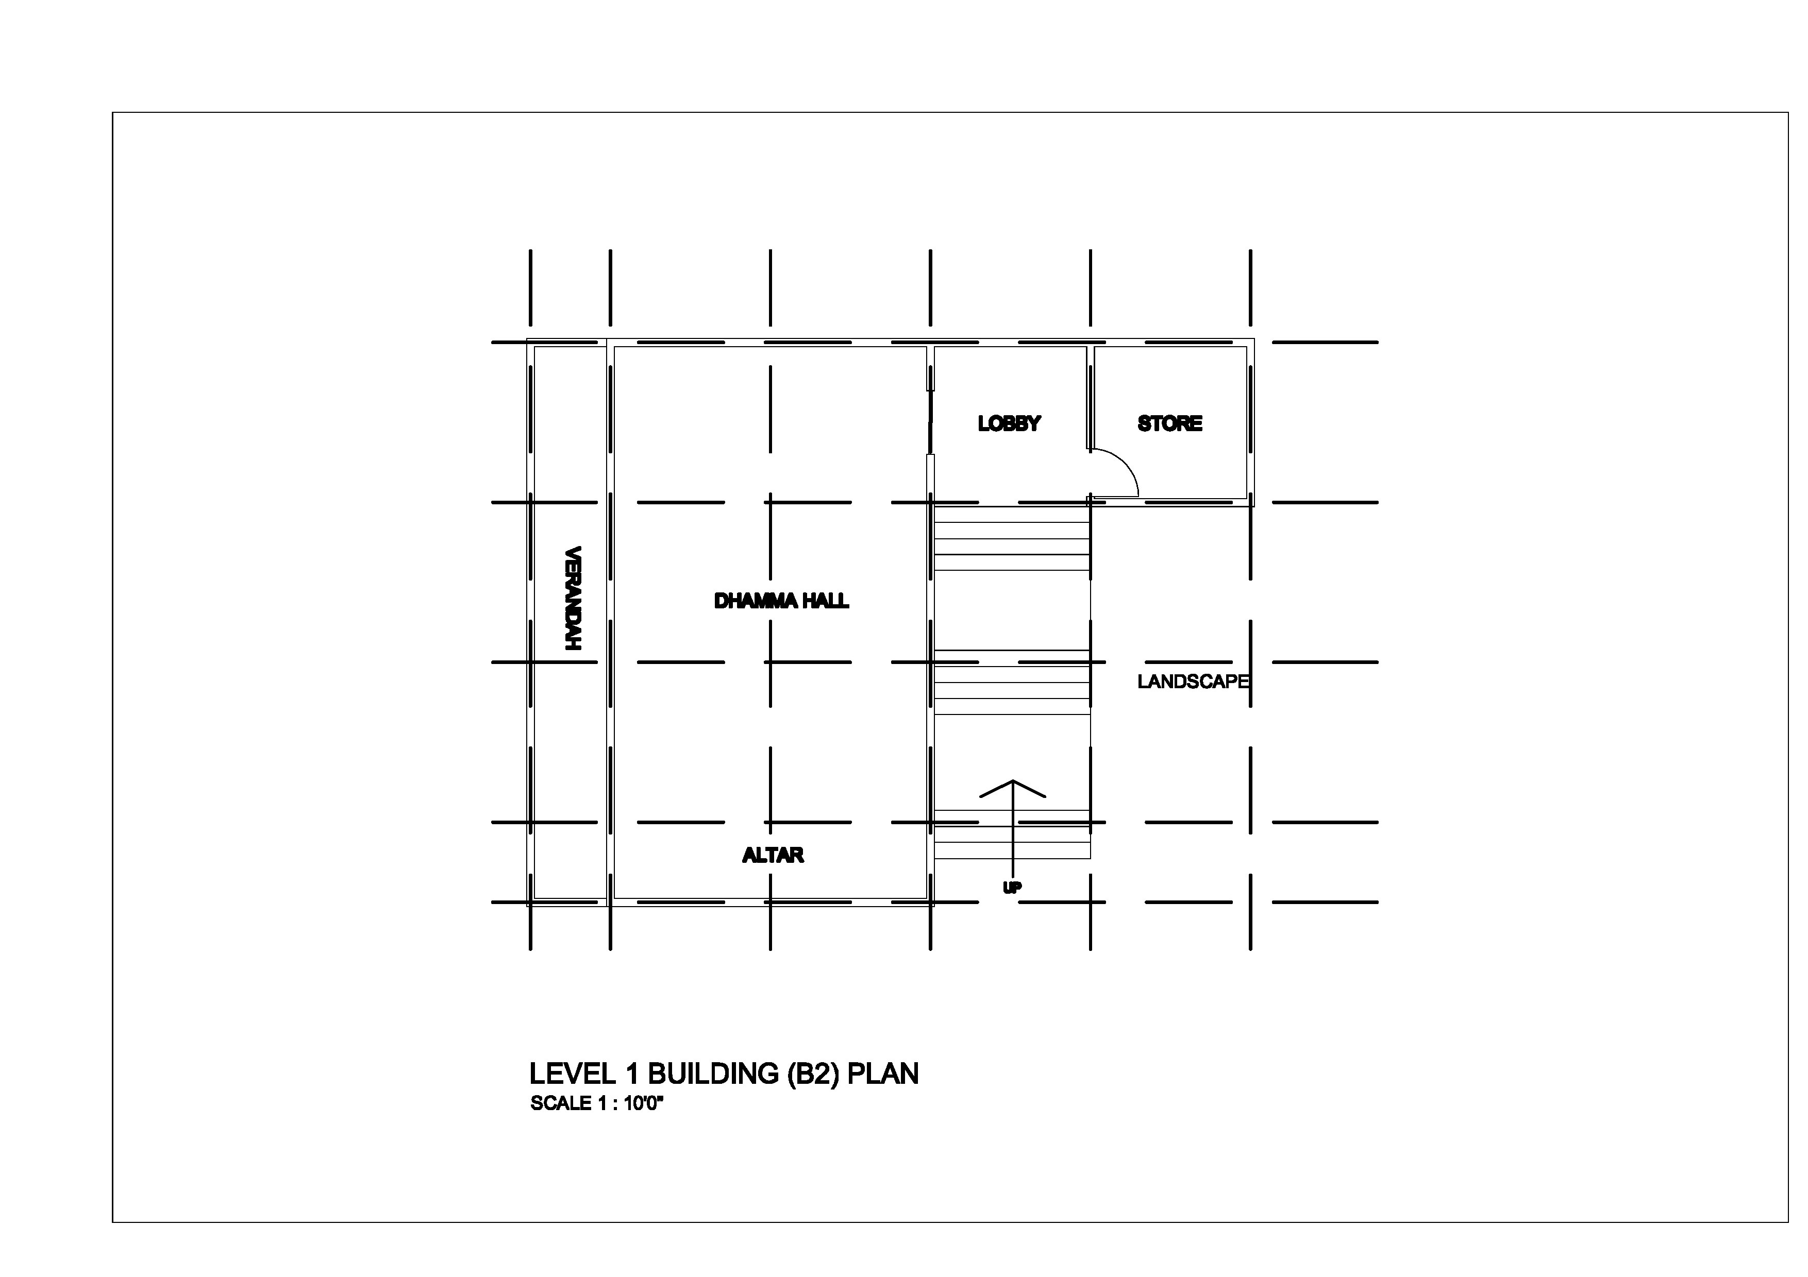

Slide 11
Be part of the vision TODAY! 当今就参与宏愿
Live the vision by donating to the new building
敬请慷慨捐献阿帕玛达禅修中心建筑基金
Donate RM5000 and above
your name will be inscribed on marble slab
Donate RM1000~RM4999
your name will be inscribed on display board
Donate RM100,000
An additional souvenir will be given
Accumulate merit and leave a legacy in the Buddha Sasana
累集功德,无量福报,佛法常存

Slide 12

Your generosity 您的慷慨
The phase 1 construction may cost RM630,000
(RM180 per sq ft)
We seek your generosity to fund this project ..
Please share with your family and friends
Unity of will is an impregnable stronghold, as long as we are united, with the devotees sending their kind metta and dana generously, sufficient funds will be fully completed soon

Slide 13
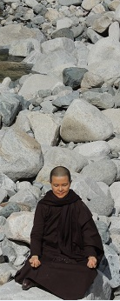
Venerable Sayalay Susila sincerely appreciates the contribution of all donors for the building fund
May this merit brings you good health, happiness and wisdom
愿此殊胜功德带给您健康、快乐与智慧
May all beings rejoice and share in this merit
愿此功德普皆回向所有的众生，共沾法益
Sadhu, Sadhu, Sadhu
善哉！善哉！善哉！

Slide 14
Objectives 目标
为善戒法师提供一个固定的道场以推动禅修与弘法事业
To provide a suitable monastery for Venerable Sayalay Susila to facilitate the propagation of meditation practices and Dhamma
为禅修者提供一个适合学习与长时期修禅的道场
To provide a suitable center for the learning and practicing of meditation on a regular basis
为众人的利益训练有法和会禅修的老师以延续佛陀的教诲
To train teachers of Dhamma and meditation to continue in the Buddha’s Dipensation for the good of the many

Slide 15

Activities 活动
1. 定期举办研经班
Conduct regular Sutta study classes
2. 长期举办禅修课程与禅修营
Organize regular meditation classes and meditation retreats
3. 编辑和传播法师的佛法教义以向世界分享
Compile and propagate the Venerable’s Dhamma teachings for sharing globally
4. 训练精通佛法和禅修技巧的老师
Train teachers proficient in the Dhamma and meditation methods

